Slide 1
Ecphrastic poetry & the development of professional literacy in physics

Slide 2
What is ecphrastic poetry?
Ecphrastic poetry is the conversation between two pieces of art. The writer interprets a work of visual art and then creates a narrative in verse form that represents his or her reaction to that painting, photograph, sculpture or other artistic creation.
http://www.firkinfiction.com/11.html

Slide 3
Ecphrastic poetry and physics
How do you write a physics-related poem ecphrastically?
Complete the following steps:
View a stimulus image and identify a physics-related concept it evokes.
If required, write down the concept, definition, law, formula etc.
Identify a suitable poetry type and write the poem.

Slide 4
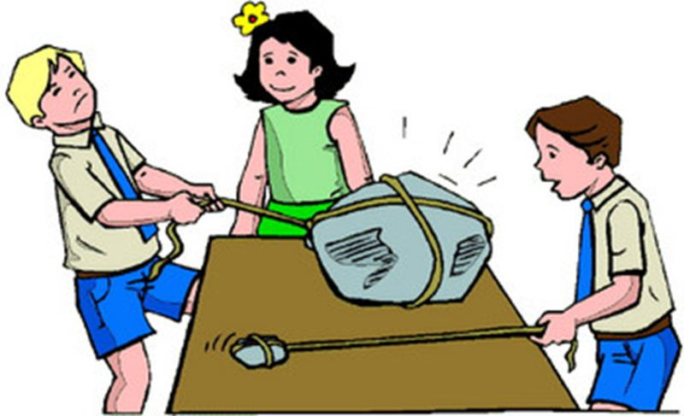
What concept does this image evoke?
http://www.glogster.com/media/2/9/12/70/9127048.jpg

Slide 5
Newton‘s 2nd Law of Motion

Slide 6
What is Newton‘s 2nd Law of Motion
The acceleration a of a body is parallel and directly proportional to the net force F and inversely proportional to the mass m.
F = ma

Slide 7
Example Haiku poem
The net force on an object is its mass times its acceleration.

Slide 8
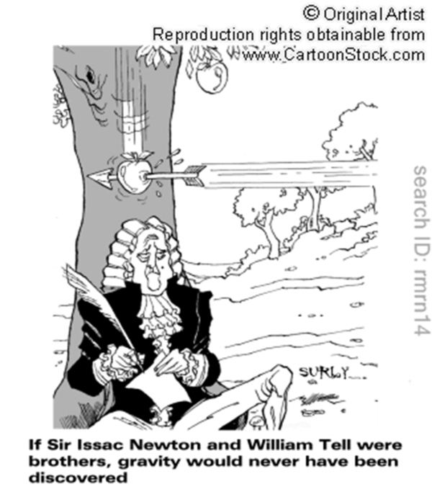
What concept does this image evoke?
http://www.cartoonstock.com/newscartoons/cartoonists/rmr/lowres/rmrn14l.jpg

Slide 9
Newton‘s discovery of gravity

Slide 10
What is significant about Newton‘s discovery of gravity?
As the image alludes to, if the legendary William Tell had been in the vicinity of Sir Issac Newton, then Newton may never have been inspired to discover gravity since William Tell would‘ve shot any falling apple before it hit Newton.
http://www.cartoonstock.com/newscartoons/cartoonists/rmr/lowres/rmrn14l.jpg

Slide 11
Example Concrete poem
___ | | __________________ | | ____________________
| The Newtons and \_| |__/ friends were taking |
| tea beneath the boughs of an apple tree |
| when a falling fruit landed on the head|
| of the head of the family. Mrs Newton|
| cried, 'Well dearie me! That could‘ve|
| caused an injury‘. But clever|
|Isaac alone could see,|
|the situation‘s true |
|gravity. |
̅ ̅ ̅ ̅ ̅ ̅ ̅ ̅ ̅ ̅ ̅ ̅ ̅ ̅ ̅ ̅ ̅ ̅
Adapted: Ben Tweedie
Original Text: Patrick Winstanley.
http://www.funny-poems.co.uk/kids/famous-poetry/h05-newton.asp

Slide 12

What concept does this image evoke?
http://makeachange1.files.wordpress.com/2010/08/jay-daniel-time-flies.jpg

Slide 13
Time

Slide 14
Example Acrostic poem
Timekeeping devices are called clocks Internation System fundamental quantity
Measured in seconds (SI unit)
Equation of acceleration, a = Δv/Δt.

Slide 15
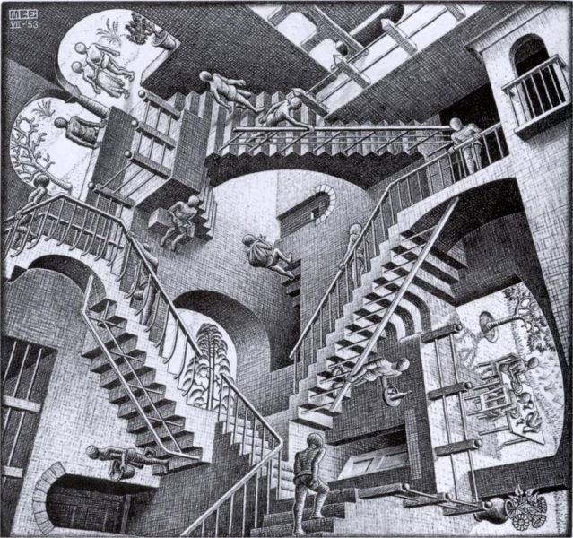
What concept does this image evoke?
http://blog.art21.org/wp-content/uploads/2010/07/Relativity-escher.jpg

Slide 16
Relativity

Slide 17
Example Limerick poem
There was a young lady named Kite
Whose speed was much faster than light.
She left home one day
In a relative way
And returned on the previous night.
http://www.freewebs.com/limericks

Slide 18
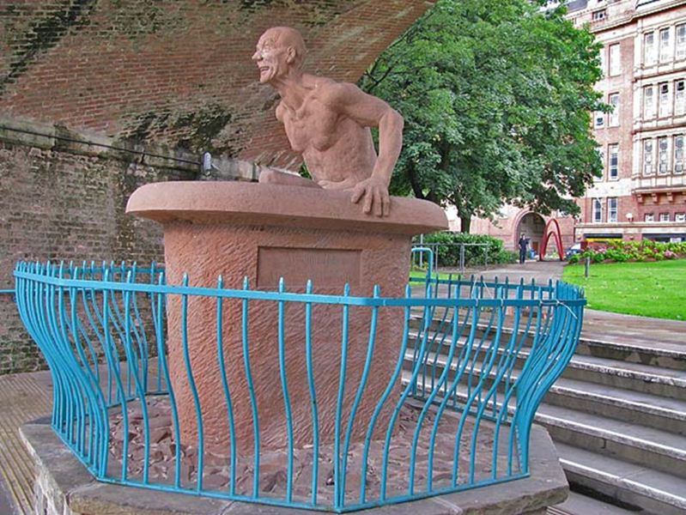
What concept does this image evoke?
http://manchesterhistory.net/manchester/tours/tour9/archimedes.jpg

Slide 19
Archimedes‘ Principle

Slide 20
Example Free Verse poem
The Sicilian King, Archimedes was told,
ordered a crown from a large lump of gold,
though the weight of the gold was completely correct,
the goldsmith's eye made the King suspect
that he'd made up the weight with some cheaper metal
and stolen some gold, that his debts he might settle.
His problem was then of outstanding immensity
as he had no idea, whatsoever, of density.
http://jcdverha.home.xs4all.nl/scijokes/2_1.html#subindex

Slide 21
Example Free Verse poem
Climbing into a bath he received a surprise
when he noticed the water beginning to rise.
He suddenly snapped, and let out a scream,
as he realised, with joy, his long-wished-for dream.
He found the upthrust, produced on a body's base,
to be equal in weight to the water displaced,
and soon volumes and weights would make it quite plain
what various metals the crown could contain.
http://jcdverha.home.xs4all.nl/scijokes/2_1.html#subindex

Slide 22
Example Free Verse poem
And so he could easily show to his Royalty
the absolute proof of the goldsmith's disloyalty.
Leaping out of the bath at remarkable rate,
he made for the palace by doorway and gate –
But the men in the street were completely confounded
to see a naked man shout "Eureka! I've found it!"
http://jcdverha.home.xs4all.nl/scijokes/2_1.html#subindex

Slide 23
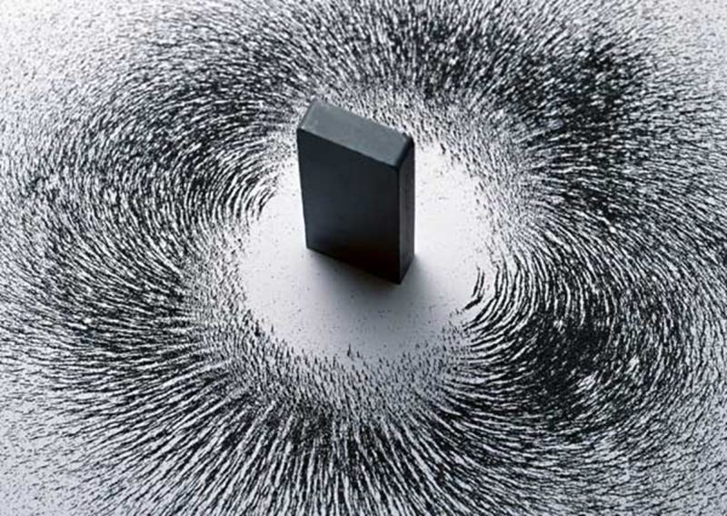
What concept does this image evoke?
http://ahmedmater.com/images/uploads/default/magnetism-ii.jpg

Slide 24
Magnetism

Slide 25
Example Cinquain poem
Magnet
Magnetic and gravitating
Draws all kinds of metal
Possessing the unbelievable power and facility
Energy
http://www.englishbaby.com/forum/AskEnglish/thread/272104

Slide 26
What concept does this musical composition evoke?
Eleanor Rigby by the Beatles.

Slide 27
Brownian motion

Slide 28
Example re-worked song lyric
Ah, look at all the little particles. (2x)
Brownian motion tries to explain how a dust mote can move when there's nothing else there except the air.
Air isn't moving - there must be something that is on the move but that we cannot see.
What can it be?
All those little particles. Why do they rise and fall?
All those little particles. Why do they move at all?
http://jcdverha.home.xs4all.nl/scijokes/2_1.html#Archimedes_3

Slide 29
Activity
Using the given stimulus material, create the following types of poetry:
Free verse
Acrostic
Cinquain
Haiku
Limerick

Slide 30
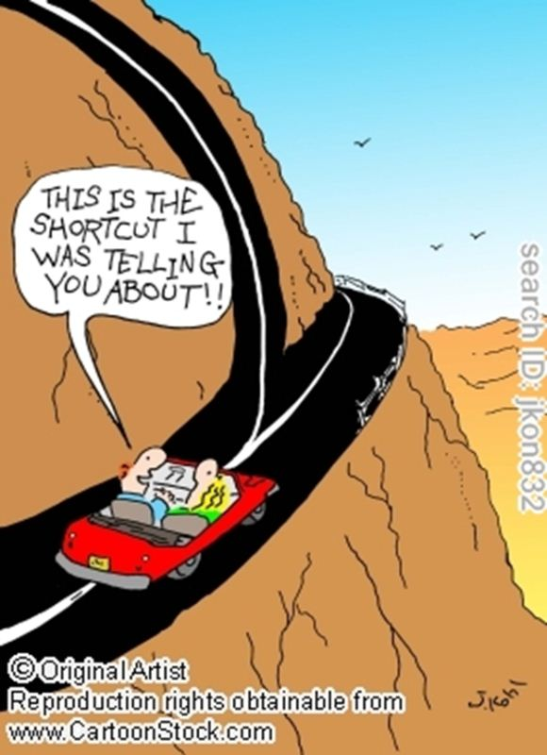
STIMULUS IMAGE 1
http://www.cartoonstock.com/newscartoons/cartoonists/jko/lowres/jkon832l.jpg

Slide 31

STIMULUS IMAGE 2
http://www.scenicreflections.com/files/Japanese_Waves_Wallpaper_dnwds.jpg

Slide 32
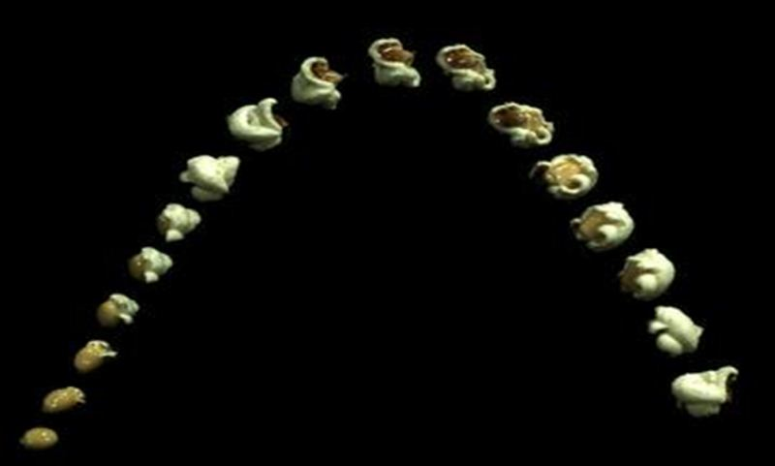
STIMULUS IMAGE 3
http://www.popcorn.org/Portals/0/Images/PoppinPopcorn.jpg

Slide 33
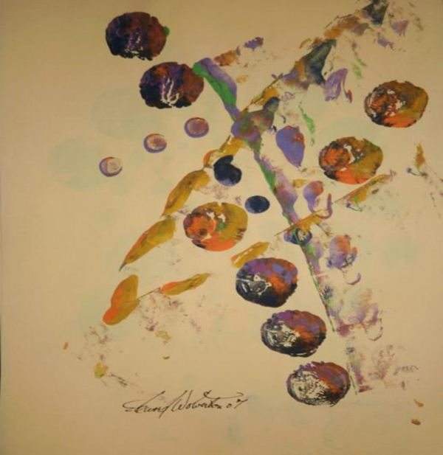
STIMULUS IMAGE 4
http://images.fineartamerica.com/images-medium/the-southern-cross-edward-wolverton.jp

Slide 34
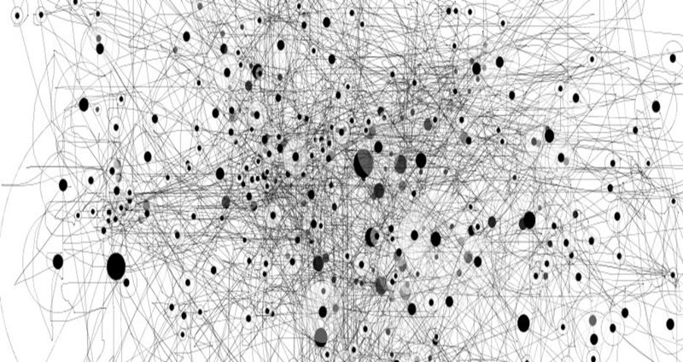
STIMULUS IMAGE 5
http://densityofspace.com/densitypaths.jpg

